Slide 1
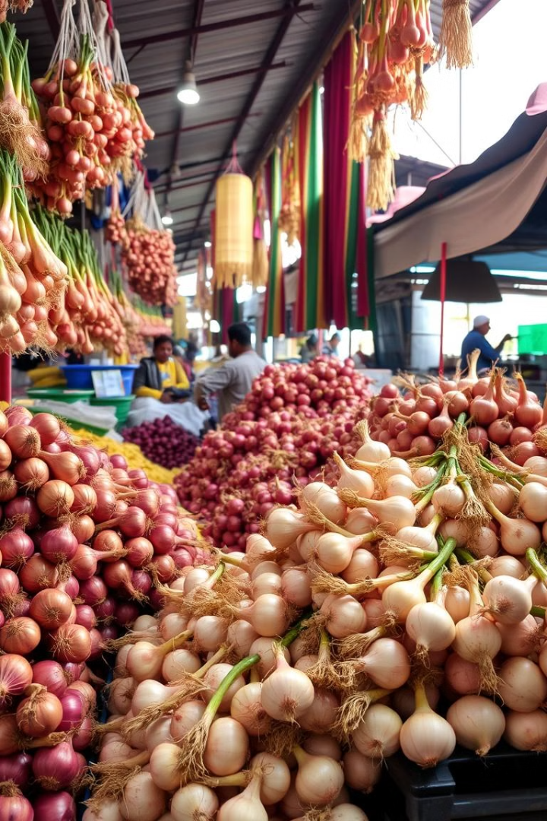
Predicting Onion Prices in India
Issue: Onion prices in India are highly volatile, leading to significant market instability. Accurate price prediction can help stabilize the market, benefiting both consumers and producers.
Goal: Develop a machine learning-based model to predict onion prices using real-time data from the Indian market, incorporating both traditional and advanced algorithms for more accurate predictions.

Slide 2

Literature Review
1
Hasan et al. (2020)
Forecasted onion prices in Bangladesh using KNN, Decision Tree, and Neural Networks. Achieved high accuracy but relied on historical data from a specific market.
2
Ahmad et al. (2021)
Examined machine learning models for onion price prediction in India.
3
Our Extension
Use real-time data from agmarknet.in with RNN and LSTM models to capture long-term price patterns and enhance accuracy.

Slide 3
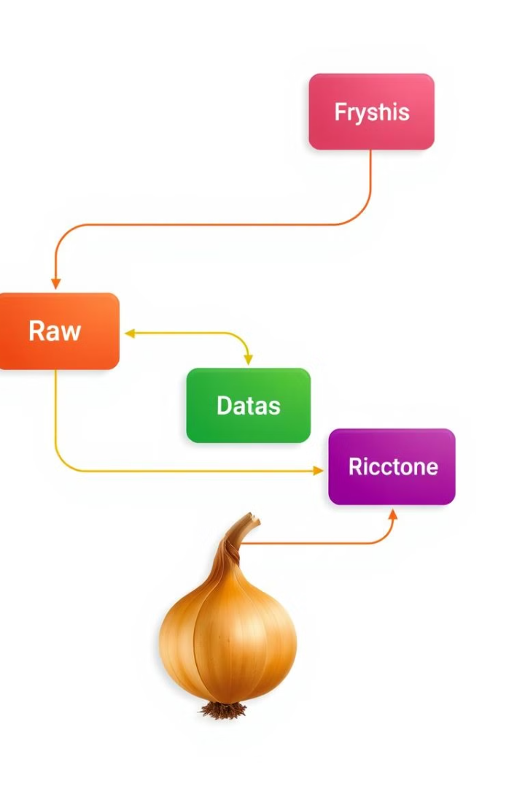




Methodology
Data Collection
Web scrape real-time onion price data from agmarknet.in.
Collect data for different regions, seasons, and other relevant factors influencing price.​
Data Processing
Clean and structure dataset for time-series analysis.
Modelling
Use traditional and advanced models like RNN and LSTM.
Evaluation
Compare models using RMSE and MAPE metrics.

Slide 4

Conclusion
Expected Outcome
Improved prediction accuracy for onion prices in India.
Market Impact
More reliable tool for managing market fluctuations.
Future Scope
Potential application to other agricultural commodities.

Slide 5

References
Hasan, M. M., et al. (2020)
"Solving Onion Market Instability by Forecasting Onion Price Using Machine Learning Approach."
Ahmad, S. M., et al. (2021)
"Impact of Machine Learning Applications for Price Prediction of Onion in India."
Nalini R
"Onion Price Prediction Based on Artificial Intelligence."

